Slide 1
Flight Ahead
Predict Flight Delays Before
Getting to the Airport
Contributors: Vidya Gadave, Shridhar Kamat,
Ajay Gopalkrishna, Brandon Reed,
Raymond Darrough, Alejandro Gutierrez,
João Pedro Fortunato
UCB Data Analytics Boot Camp
Project 04, Group 04 | August 21, 2023
Notes:
Brandon

Slide 2


The Problem
Air travel today is fraught with delays for multiple reasons: shortages of staff, crew, air traffic controllers, flight attendants, and pilots. In addition, weather, equipment, and system malfunction have also contributed to delays and cancellations.
Our Solution
We analyzed historical data from 2018 on the schedule of flights, airports, airlines, and additional data points to predict the likelihood of a flight getting delayed.
Notes:
Brandon

Slide 3
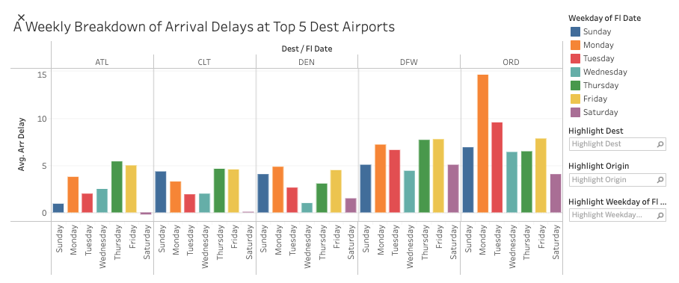
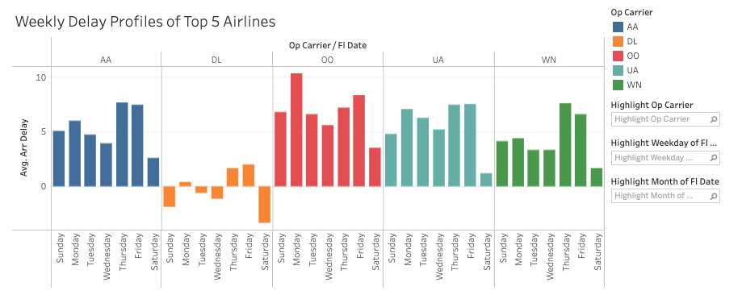
Flight Delays in 2018: Top 5 Airports & Airlines
Why Top 5?
Simplicity
Easier analysis.
Manageable data
Accuracy
Consistent delay patterns
Better predictions.
Relevance
Matches common experiences.
Practical predictions.
Tableau story here
Notes:
Alej: As you can see in the visuals displayed, we focused on the top 5 airports and airlines for our analysis.
We honed in on the dataset to simplify analysis and ease data management. Accuracy would be improved as we observe consistent delay patterns among the top 5. This leads to better predictions. Lastly, our focus on Relevance – mirrors common experiences for more practical predictions. Some of the key insights shown here are: Traveling with Delta Airlines is above and beyond the best. 4 of 7 days the average arrival is early. You don’t want to fly to Ohare on a Monday. There, Most days you’re looking at a delay. Travelers on Saturdays and Wednesdays arrive on time more often.

Slide 4





WE WILL ADD A VISUAL OF THE DASHBOARD HERE
Let’s give it a try!
Our model helps future flyers determine the optimal flight to mitigate the chance of a delay.
Simply input the following to see if your planned flight is predicted to be on time or delayed:
Origin & destination
Airline
Time of day
Day of the week
Season
Notes:
Demo: Ajay

Slide 5
How did we get here?
Model Exploration and Assessment
Notes:
Ajay

Slide 6
Preprocessing the Data
Feature Engineering:
Times → Morning, Afternoon, Evening, Night
Months → Seasons
Date → Weekday
Incorporating Weather:
Bolstered 2018 data set with daily precipitation, snowfall, and snow depth data from NOAA.
Customer vs. Industry Lens:
Experimented with removing and adding columns to tailor the model to customers or industry professionals.
Data sources:
2018 flight data
2018 daily weather data
Notes:
Brandon

Slide 7
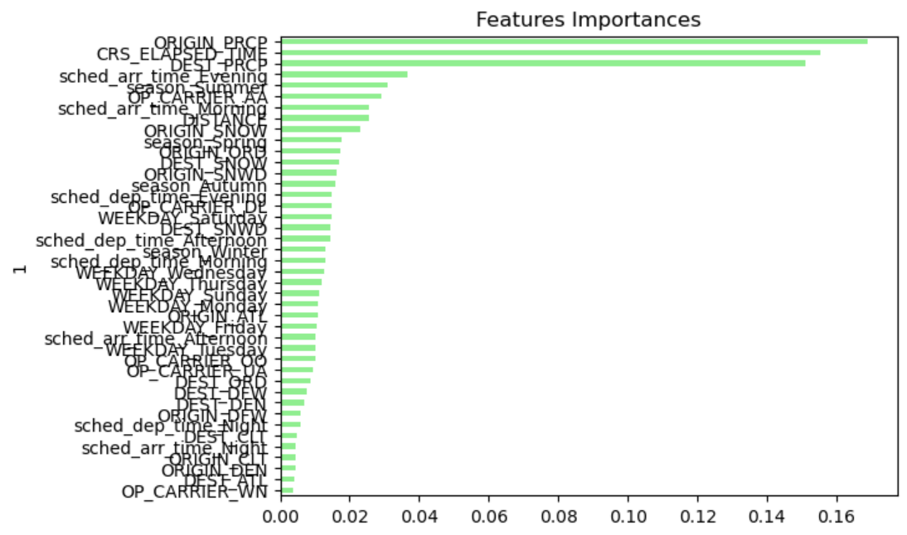
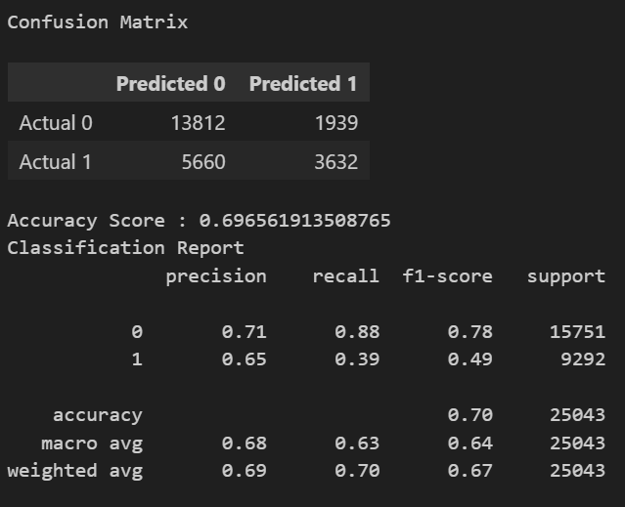
Model Option A
Gradient Boosted Trees
Combining multiple decision trees to predict flight delays. Requires time-consuming tuning of hyperparameters.
Results:
Nearly 70% accuracy when weather data included
~65% accuracy without weather data
Use case: Customer
Notes:
Brandon

Slide 8
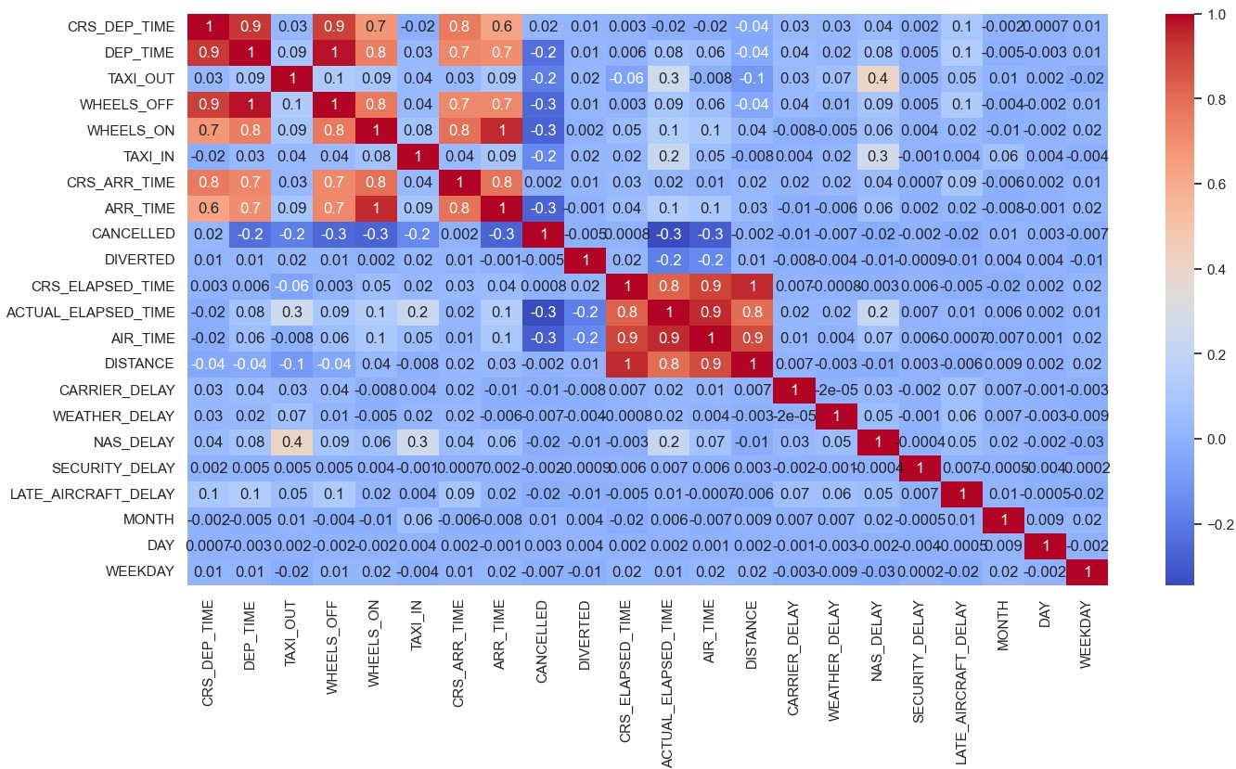
Model Option B
Neural Net Model
Designed this model to predict flight delays and flight diversions.
Results:
68% accuracy in predicting flight delays
98% accuracy in predicting flight diversions
Use case: Customer
Notes:
Ajay: Total of 3090 parameters and 6 layers

Slide 9
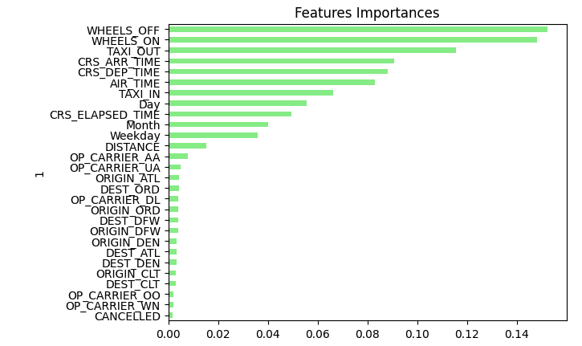
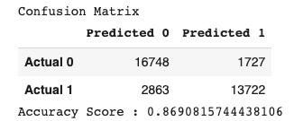
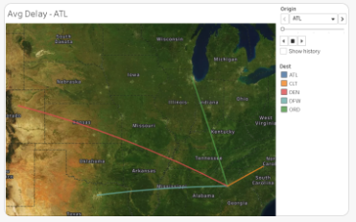
Model Option C
Logistic Regression and Random Forest Classifier
Logistic Regression: tried all solvers through a loop. Random Forest Classifier: delivered better accuracy.
Results:
~50% accuracy with Logistic Regression
86% accuracy with Random Forest Classifier
Use case: Industry
Notes:
Shridhar:

Slide 10
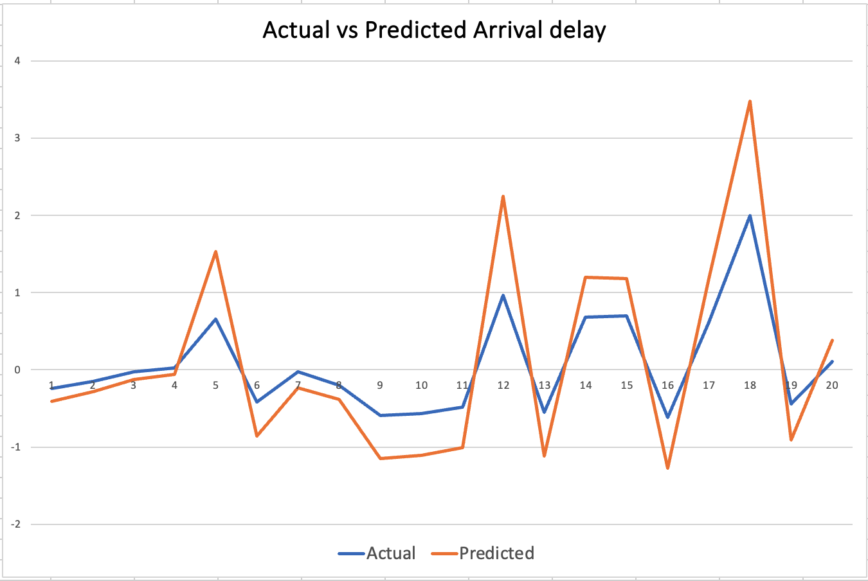
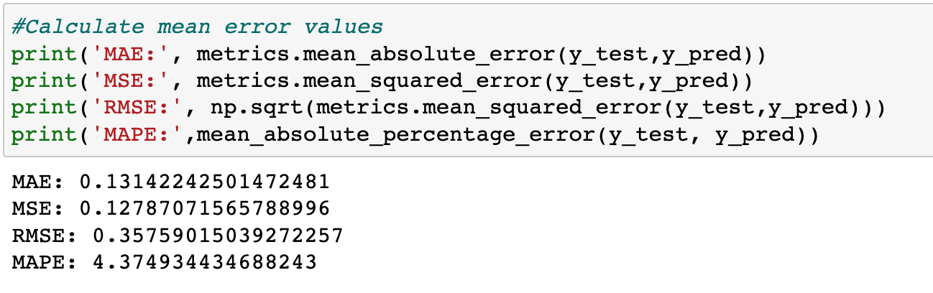
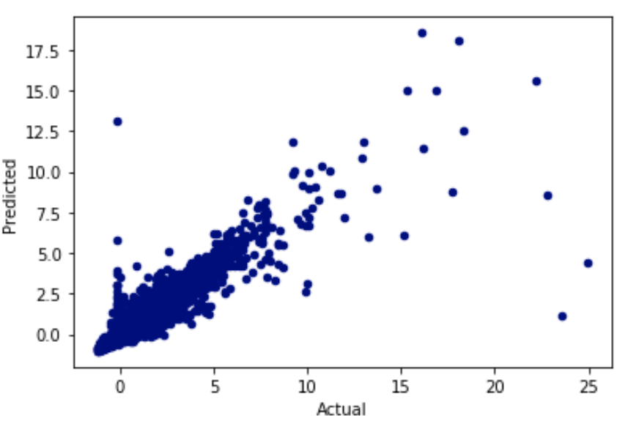
Model Option D
Random Forest Regressor
Predicting value of the arrival delay with this model.
Results: Score 86%
Mean error values-
Use case: Industry
Notes:
Vidya

Slide 11
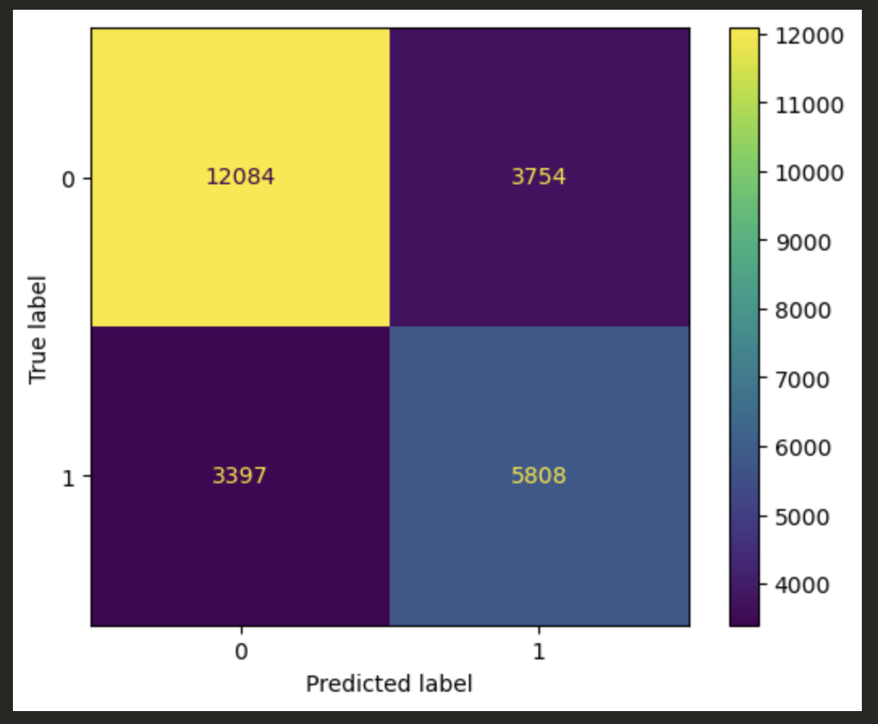
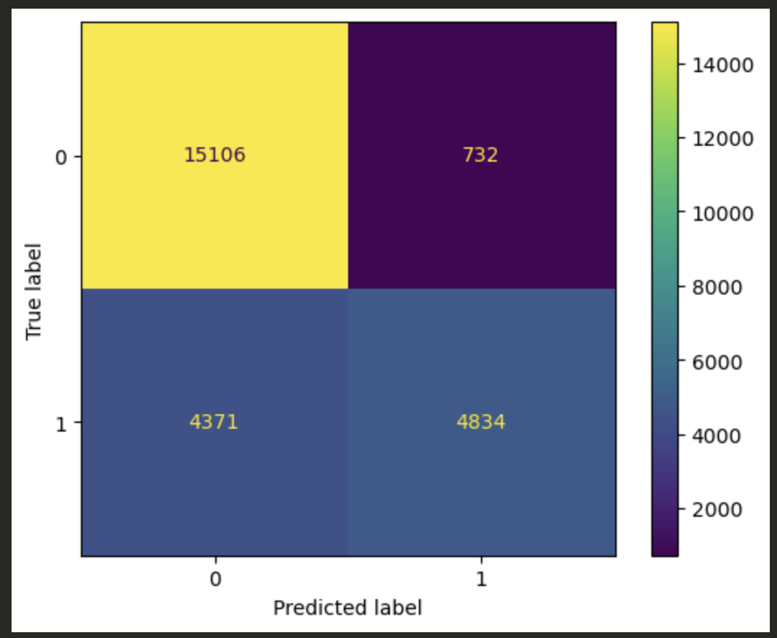
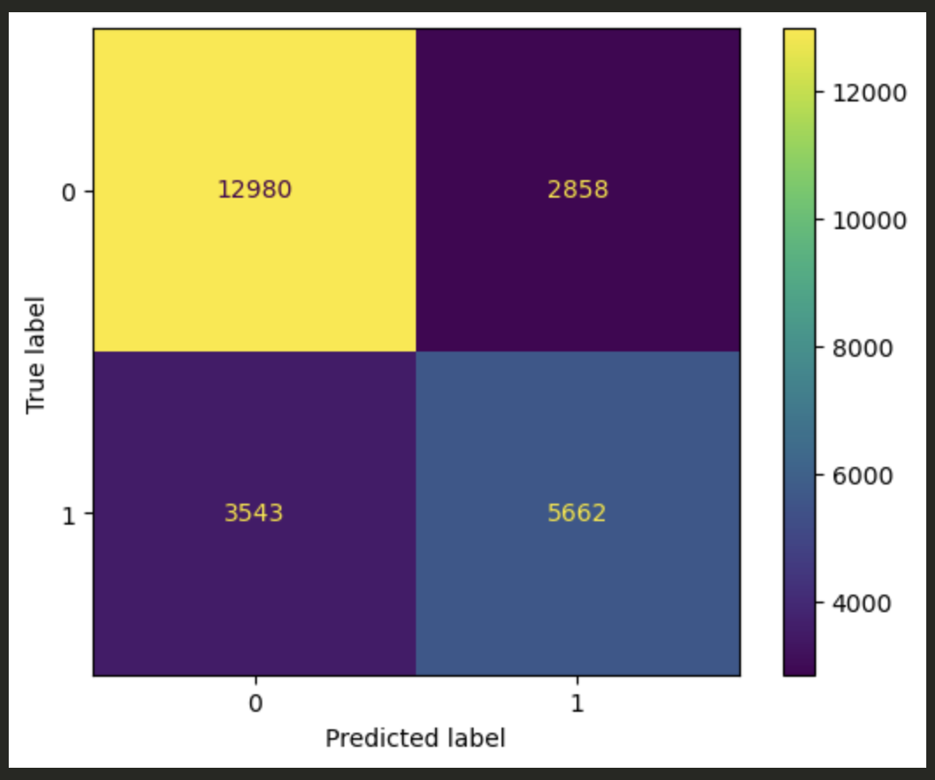
Model Option E
Decision Trees
Predict if flights are delayed (1) or not (0)
Results: ~ 71-79%:
Baseline DT Model
Tuned DT
ADA DT
Use case: Industry
Notes:
Alej:
I focused on decision tree models and took a go at 3 variations. My target audience was airline industry professionals to help them forecast delays.
The baseline model test accuracy was lowest at 71%, ADA was in between at 74%, and the tuned model was highest at 79%.
When we dig deeper we see that:
The baseline model correctly predicted 77% of on-time flights, but also had 24% false positives, mislabeling on-time flights as delayed.
The tuned model improved the false positives down to just 5%, but missed 39% of actual delays.
The AdaBoost model was a balance - it had 18% false positives and 51% true positives.
Overall, the tuned model performed best, with 95% true positives for on-time flights and 55% true positives for delays.
These initial results show machine learning can forecast delays fairly accurately, with ~75% overall accuracy across the models.

Slide 12
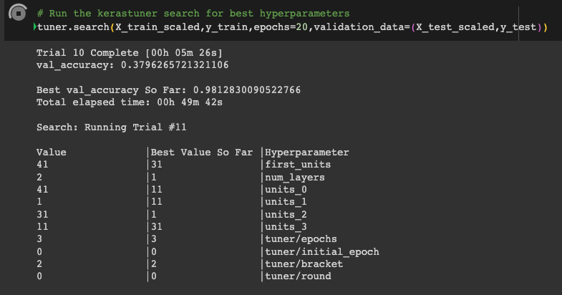
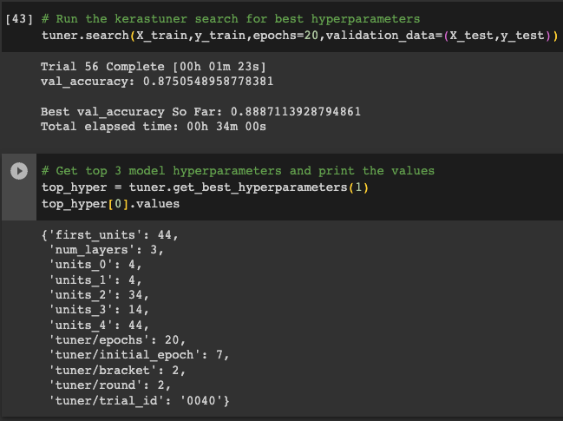
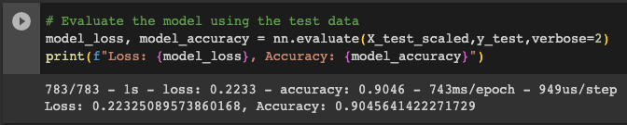
Optimizing Neural Net
Keras Tuner
Results:
90% accuracy in predicting flight delays
99% accuracy in predicting flight cancelation, delay and diversion.
Use case: Optimization
Notes:
Joao:

Slide 13
We tried a lot of options and ultimately landed on the Gradient Boosted Trees model.
Linear Regression and Random Forest Classifier
Decision Trees
Keras Tuner
Gradient Boosted Trees
Random Forest Regressor
Neural Net
but there’s room for improvement …
Notes:
Joao:

Slide 14
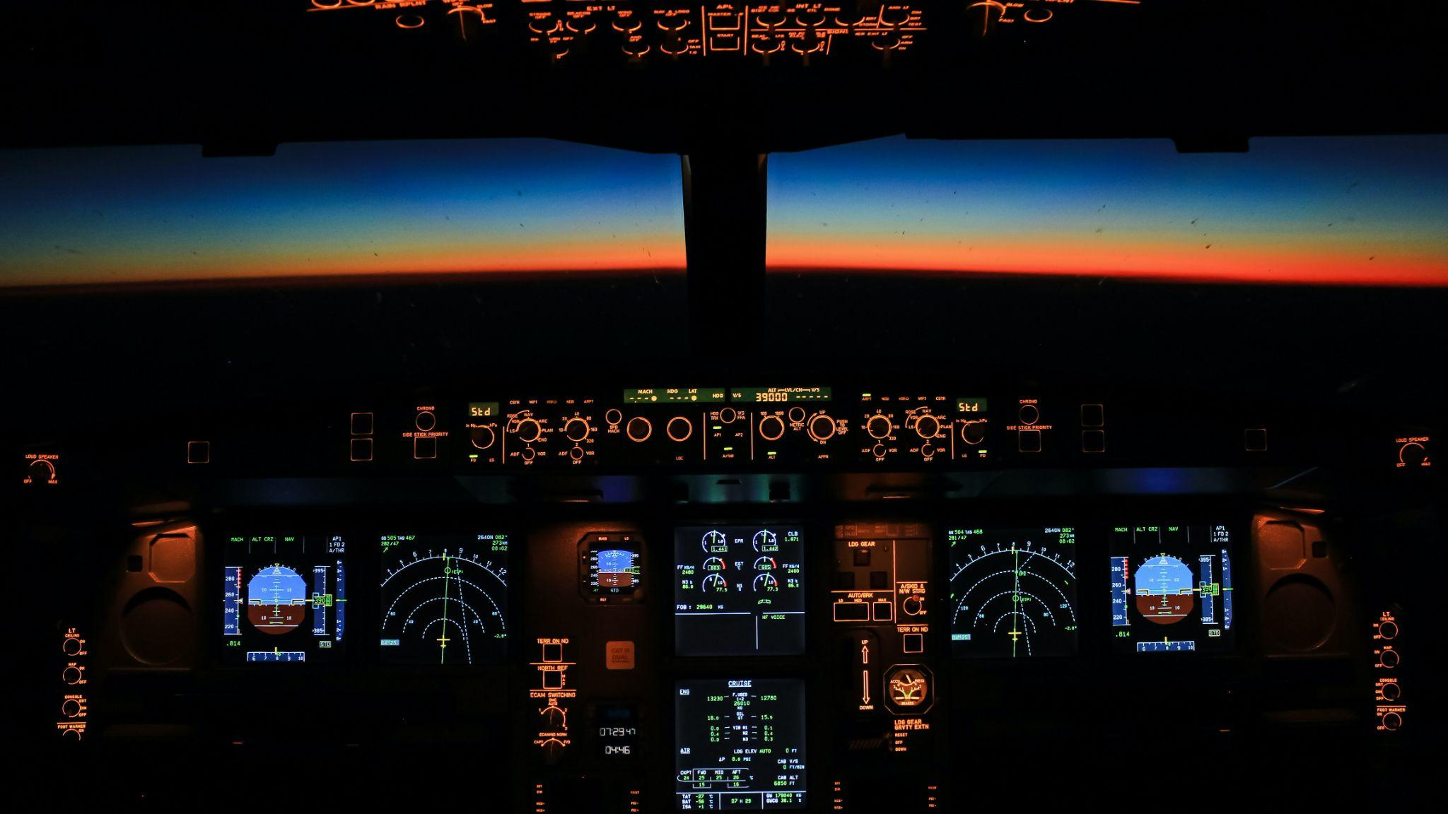
Challenges
Processing the size of the flight data CSV files (10+ years’ worth of flight data)
Too many origins, destinations, and airlines to reasonably incorporate into the model
Calibrating the best data mix to include in the model
Finding and incorporating relevant weather data into the model (need more funding!)
We have limited resources in our laptop / Google Collab for processing such a large dataset
Reducing multicollinearity in the models
Notes:
Raymond:

Slide 15

Future Plans & Next Steps
Incorporate all airlines across all the airports
Incorporate more historical data (2009-2017) and gather more recent data (our dataset only went until 2018)
Incorporate other factors that might impact delays (e.g., security, airport administration, etc.)
Gather data around number of incoming and outgoing flights per hour by airport
Incorporate real-time data to make the model current
The sky’s the limit …
Notes:
Raymond:

Slide 16
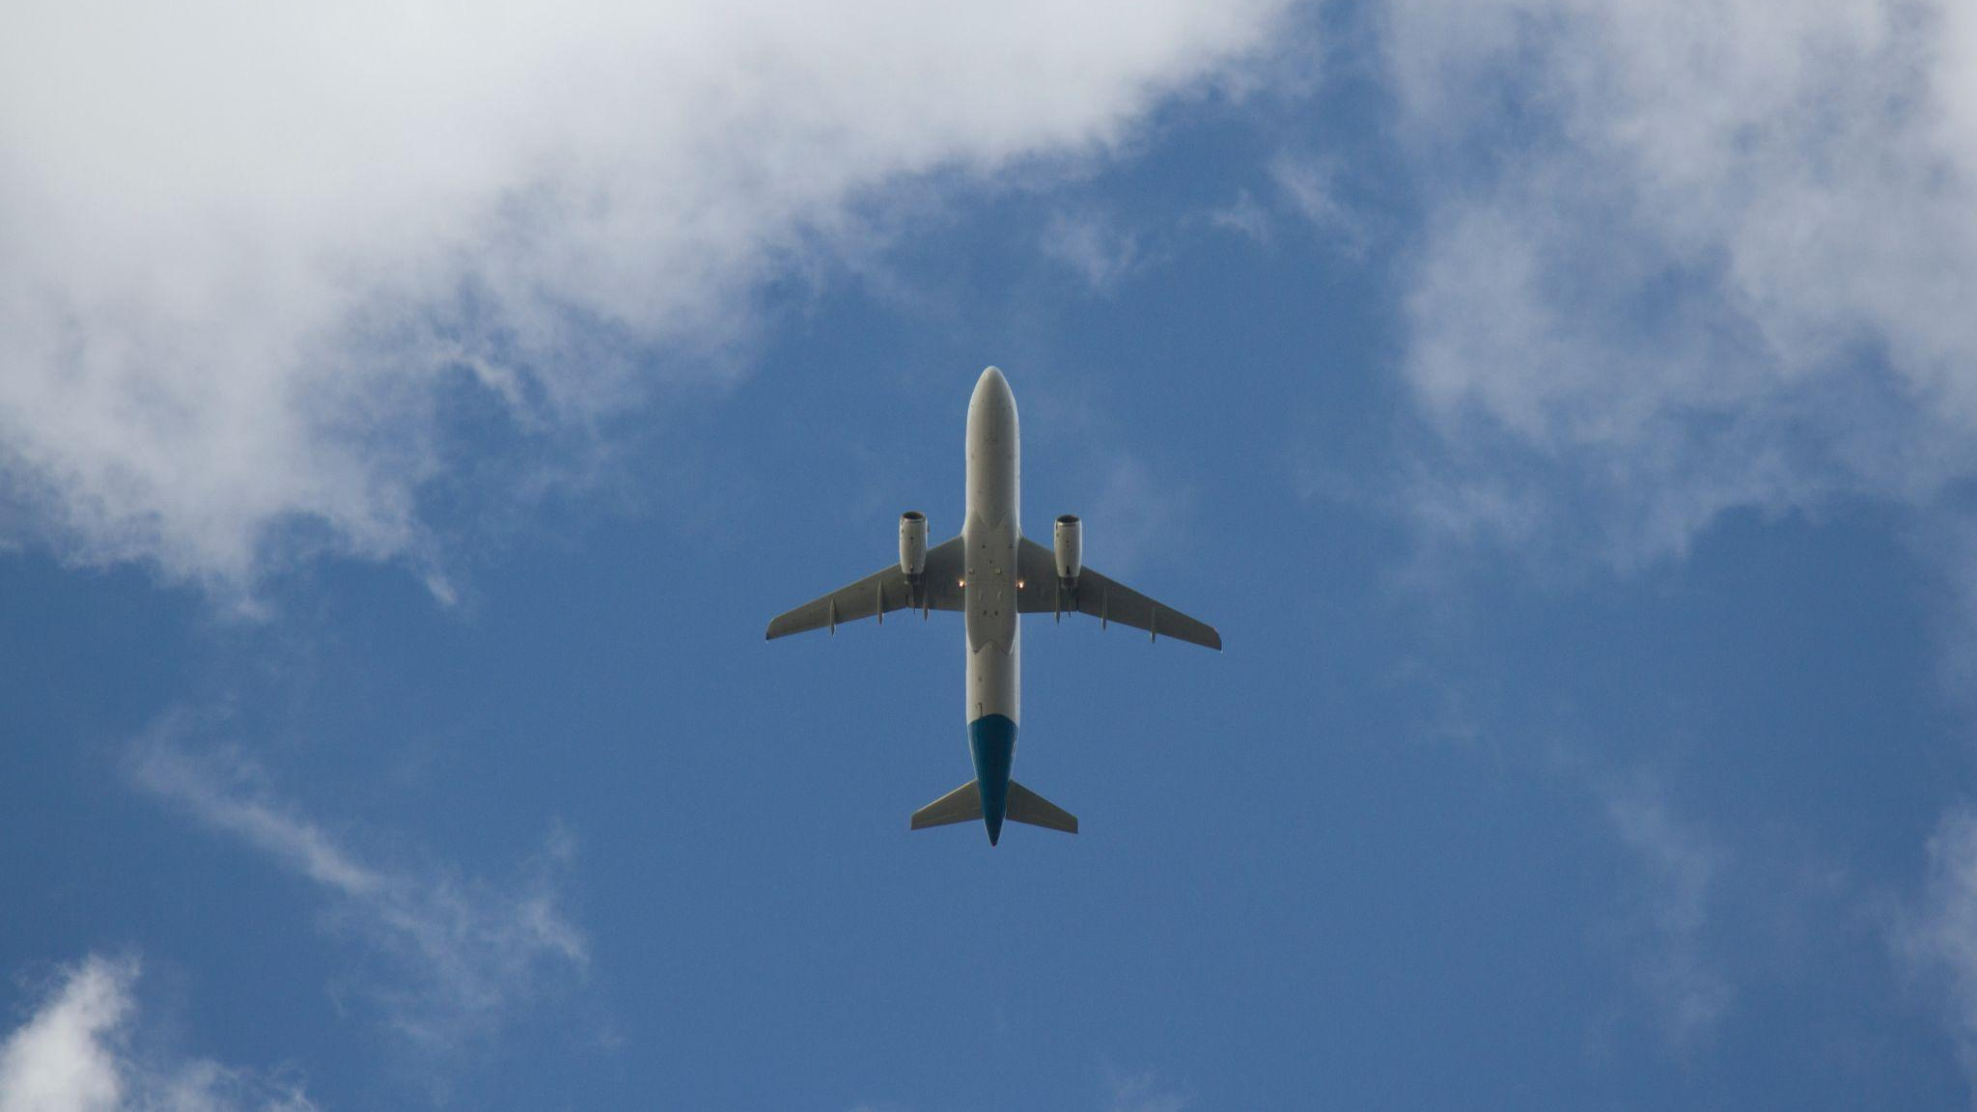
Questions?
Thank you!

